Slide 1
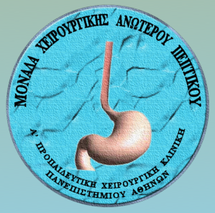
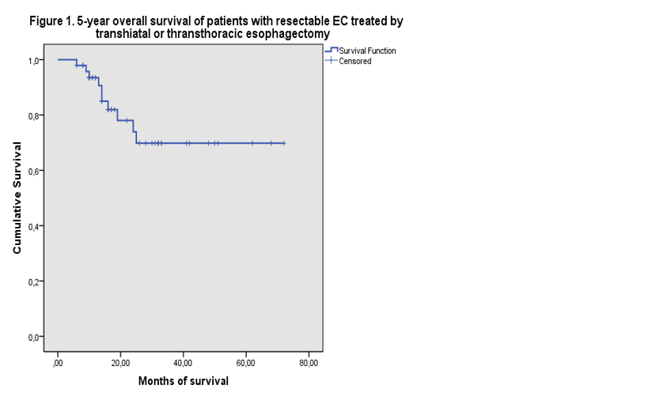
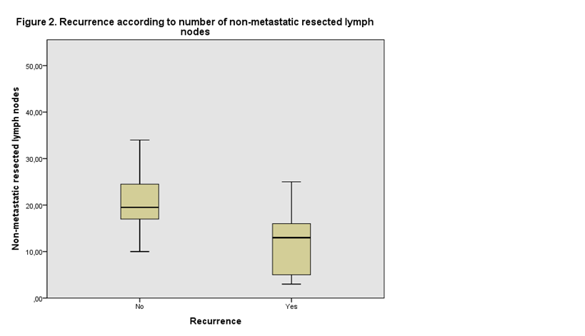
THE NUMBER OF RESECTED NON METASTATIC LYMPH NODES PREDICTS THE OUTCOME IN PATIENTS WITH ESOPHAGEAL CANCER. Georgia Doulami, Zoi Vrakopoulou, Nikolaos Memos, Nikolaos Kokoroskos, Stamatina Triantafyllou, Eleftheria Kleidi, Georgios Zografos, Dimitrios Theodorou. Department of Foregut Surgery, 1st Propaedeutic Surgical Clinic, “Hippokration” General Hospital, National and Kapodistrian University of Athens, Greece.
OBJECTIVES
The value of the extend of lymph node dissection during esophagectomy for treatment of esophageal cancer (EC) has been debated for many years. A randomized trial by Omloo et al showed that patients with EC and one to eight positive lymph nodes benefit from a transthoracic esophagectomy (TTE) with an extended lymph node dissection, thus giving an answer to the debate in favor of extended lymph node dissection in selected patients [1]. Recently the metastatic lymph node ratio (LNR= positive lymph nodes/total number of excised lymph nodes) has been associated with oncological outcome [2,3].
Our aim was to investigate the possible correlation of non metastatic dissected lymph node number (NMLN) with overall survival in patients with EC.
PATIENTS AND METHODS
From January 2006, all patients with resectable EC undergoing surgery with intention-to-treat were prospectively enrolled in a database. Data on patients’ demographics, tumor, operation, postoperative course, pathology exam and follow up were collected.
Patients were treated with transhiatal esophagectomy (THE) or transthoracic esophagectomy (TTE), according to their physical status and the presence of early disease.
Statistical analysis was performed with SPSS 19.
RESULTS
In a total of 48 patients, 30 underwent THE (62.5%) and 18 underwent TTE (37.5%). Mean patients’ age was 58.51 years (SE=1.82) and 85.4% were men (n=41). As for lymph node involvement, 19 patients (39.6%) had no lymph node metastasis (N0), 8 (16.7%) had 1 or 2 metastatic lymph nodes (N1), 12 (25%) had 3 to 6 positive lymph nodes (N2) and the remaining 9 (18.7%) patients had 7 or more positive lymph nodes (N3).
Median number of total excised lymph nodes (TLN) was 22 (range=4-60), mean number of metastatic lymph nodes (MLN) was 4 (SE=0.99) and mean number of NMLN was 20.3 (range=3-46). Mean follow-up time was 22.17 months (0-72).
Patients overall 5-year survival was 69.8% with mean survival 55.23 months (SE=4.57) (figure 1). Cox unifactor and multifactor regression analysis adjusted for age, sex, grade, or type of surgery revealed that the number of NMLN positively correlated with overall survival (p=0.023). This correlation is stronger if patients with N0 disease are excluded, as subgroup analysis of patients with at least one positive lymph node revealed a positive correlation of NMLN with overall survival (p=0.007).
Recurrence rate was 29.2% (n=14). Patients with recurrence had a lower number of non-metastatic lymph nodes compared with patients who were disease free (15 vs 22.2, respectively, p=0.030).
DISCUSSION
Number of resected lymph nodes in esophageal surgery has been previously discussed as for its probable impact on patients’ survival [4]. The ideal number of resected lymph nodes in order to improve patients’ survival although extensively discussed, has not been agreed [5,6]. In addition, in literature exist a few studies assessing the impact of non-metastatic resected lymph nodes on survival of patients with EC treated with esophagectomy [7,8]. The number of non-metastatic resected lymph nodes reflects the extent of lymphadenectomy taking into account the number of resected lymph nodes and could be applied in order to compare lymphadenectomies of dissimilar extent.
We revealed that non-metastatic resected lymph nodes positively correlate with patients’ overall survival and recurrence rate.
CONCLUSION
Overall survival of patients with EC, especially of those with a node positive status may be related with the extend of lymph node dissection, implying that not only the number of metastatic lymph nodes but also the number of total excised lymph nodes may affect patients’ survival.
References:
Omloo JM, Lagarde SM, Hulscher JB, et al. Extended transthoracic resection compared with limited transhiatal resection for adenocarcinoma of the mid/distal esophagus. Five-year survival of a randomized clinical trial. Ann Surg 2007; 246(6):992-1000.
Greenstein AJ, Litle VR, Swanson SJ, Divino CM, Packer S, Wisnivesky JP. Prognostic significance of the number of lymph node metastases in esophageal cancer. J Am Coll Surg 2008; 206(2):239-246
Mariette C, Piessen G, Briez N, Triboulet JP. The number of metastatic lymph nodes and the ratio between metastatic and examined lymph nodes are independent prognostic factors in esophageal cancer regardless of neoadjuvant chemoradiation or lymphadenectomy extend. Ann Surg 2008; 247: 365-371
Akutsu Y, Matsubara H. The significance of lymph node status as a prognostic factor for esophageal cancer. Surg Today 2011; 41:1190-1195.
Chen YJ, Schultheiss TE, Wong JYC, Kernistine KH. Impact of the number of resected and involved lymph nodes on esophageal cancer survival. Journal of Surgical Oncology 2009; 100:127-132.
Peyre CG, Hagen JA, DeMeester SR, et al. The number of lymph nodes removed predicts survival in esophageal cancer: an international study on the impact of extent of surgical resection. Ann Surg 2008;248(4):549-56.
Hsu PK, Huang CS, Wang BY, Wu YC, Chou TY, Hsu WH. The prognostic value of the number of negative lymph nodes in esophageal cancer patients after transthoracic resection. Ann Thorac Surg 2013;96(3):995-1001.
Schwarz RE, Smith DD. Clinical impact of lymphadenectomy extent in resectable esophageal cancer. J Gastrointest Surg 2007 ;11(11):1384-93.

